Slide 1


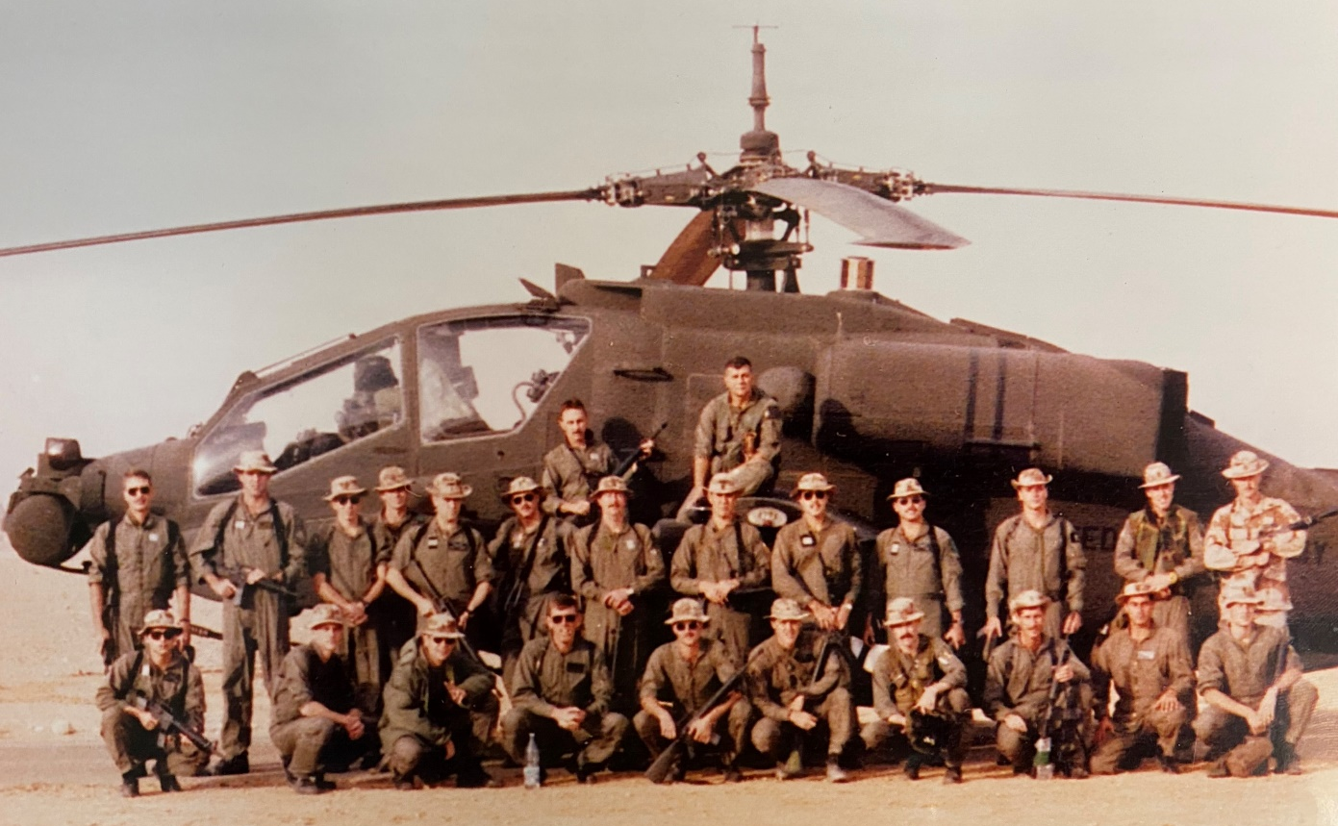
TASK FORCE NORMANDY
Staff Ride
1st Battalion, 101st Aviation Brigade
17 January 1991

Slide 2
Agenda
STAND 1: Background
STAND 2: Mission Planning
STAND 3: Pre-Mission Prep
STAND 4: Movement / Actions on the Objective
STAND 5: Post-Mission
INTEGRATION

Slide 3
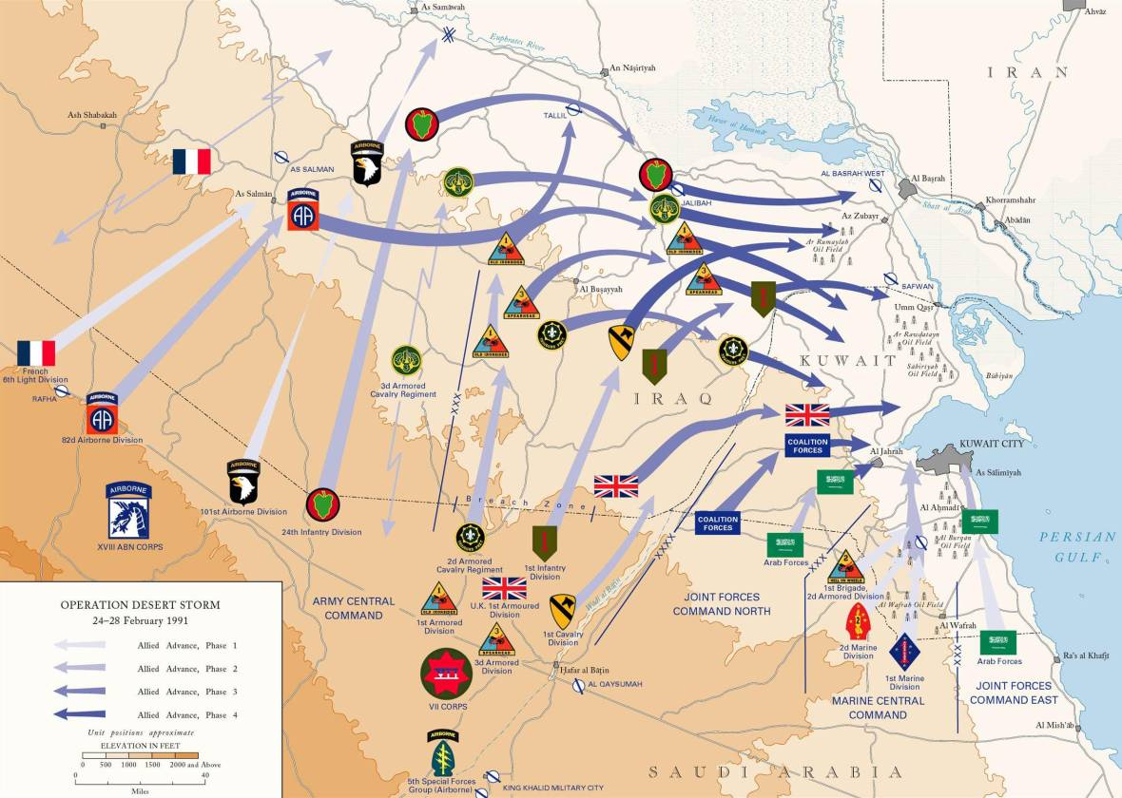
STAND 1
Background
1-1

Slide 4
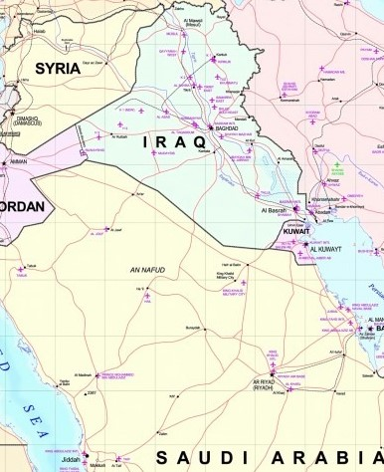
Road to War
Iraq / Kuwait Background
23 July – Iraqi troops move south
2 August – Iraqi invasion
UNSC Resolutions
8 August – First US units deploy
1-2

Slide 5
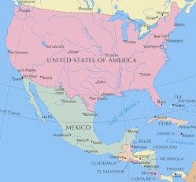


101st Locations Prior to Deployment
10 August – Deployment orders received
Units supporting training exercises at West Point
Deployed to Honduras and Panama
Prepping for upcoming MFO Mission in the Sinai
1-3

Slide 6
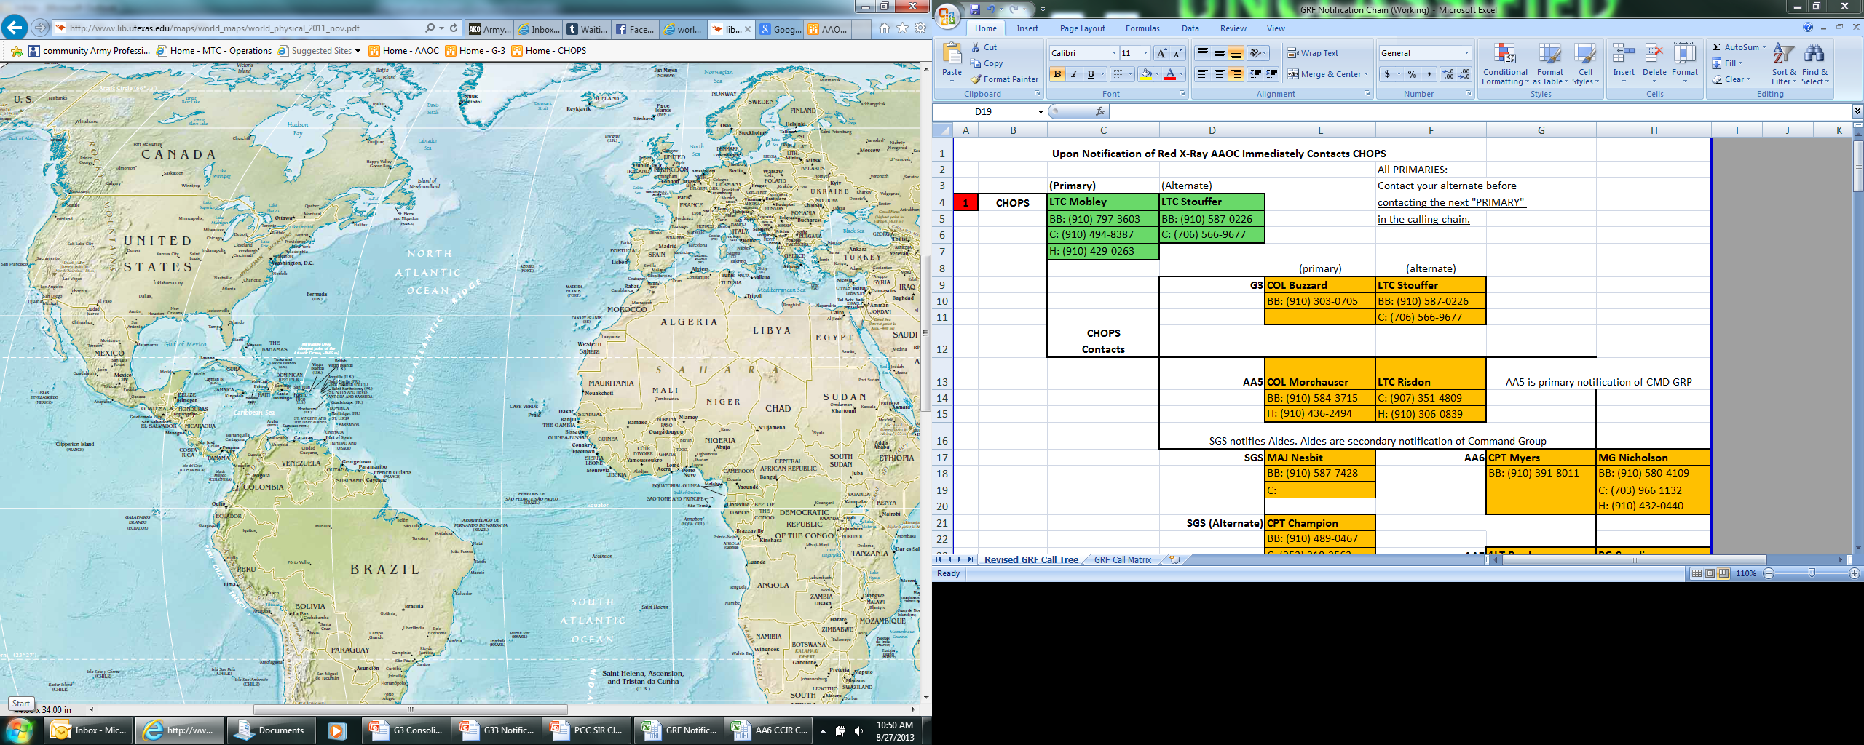
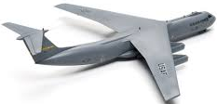
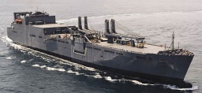
101st Airborne Division Deployment
XX
101
XXXXXX
CENTCOM
Very rapid deployment
  Division advance party in Saudi Arabia – 5 days
  First aircraft (with Apaches onboard) departed – 7 days
  First ships departed – 9 days; final ships departed – 31 days
  Division closed in Saudi Arabia – 57 days
1-4

Slide 7
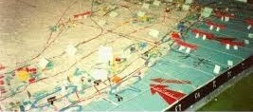
STAND 2
Mission Planning
2-1

Slide 8
Mission Development
Iraqi networks were within a powerful electronic warfare radar “fence”.
Sites about forty miles apart with overlapping radar coverage.
  Destroying three adjoining sites would let a hundred bombers through.
  Destroying two adjoining sites narrowed the gap to the minimum necessary.
  Destroying only one site was useless; overlapping coverage would fill in the gap.
Sites had to be destroyed at the same time.
Conventional aircraft or cruise missiles could be used
  No means to assess damage or know if the targets were truly destroyed.
Helicopters were considered the best option
  Could stay on station, assess damage, and reengage targets until nothing was left.
2-2

Slide 9
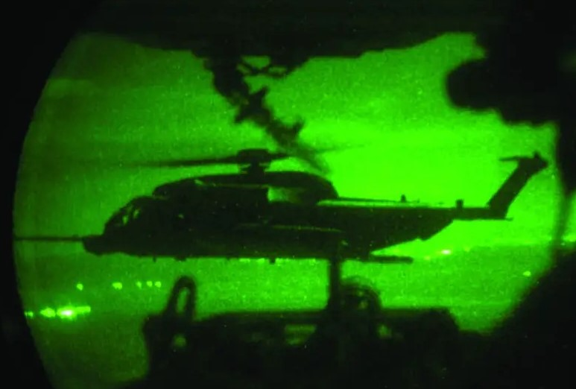
Determining the Correct Mission Force
Pave Low capabilities
Apache capabilities
COL Johnson outlined a joint force of Apaches and Pave Lows infiltrating into Iraq to destroy radar and ground-control interception sites.
Pave Lows would lead and navigate; Apaches would follow and then move to their objectives.
2-3

Slide 10
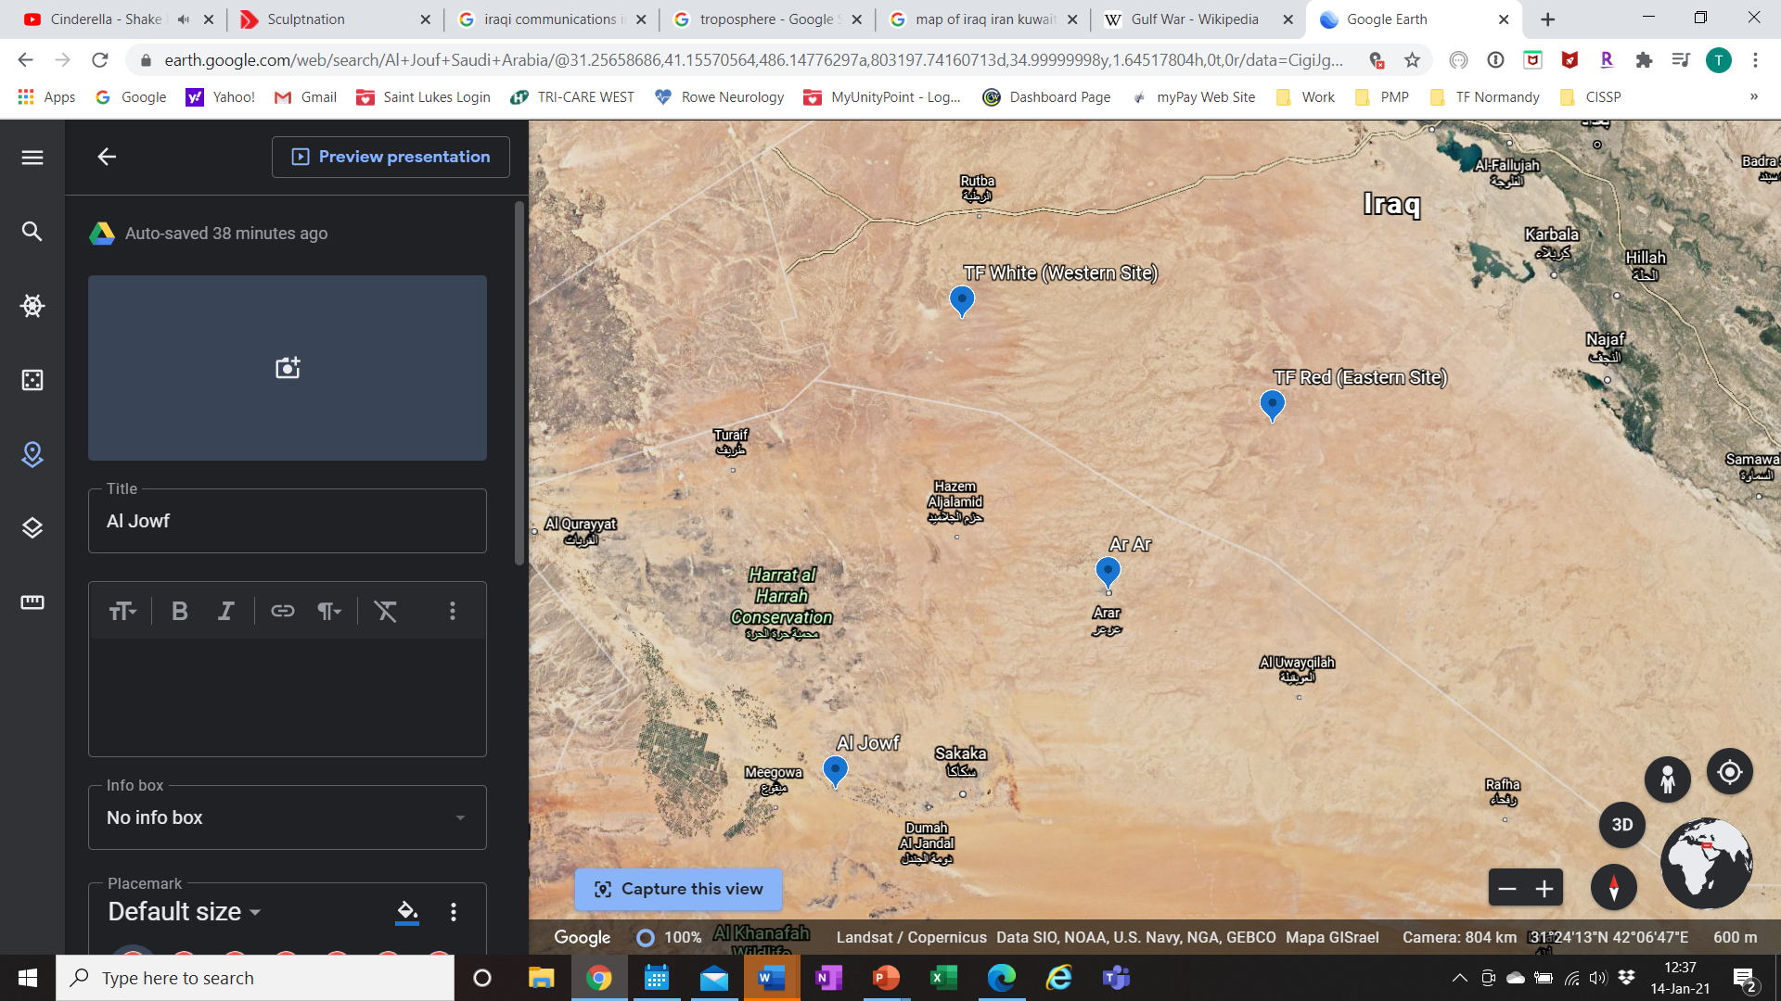
TF Normandy Mission
40 Miles
Iraq
Saudi Arabia
Iraq
Saudi Arabia
On order, destroy three early warning radar sites within Iraq to open coalition flight paths.
Al Jouf
Al Jouf
2-4

Slide 11
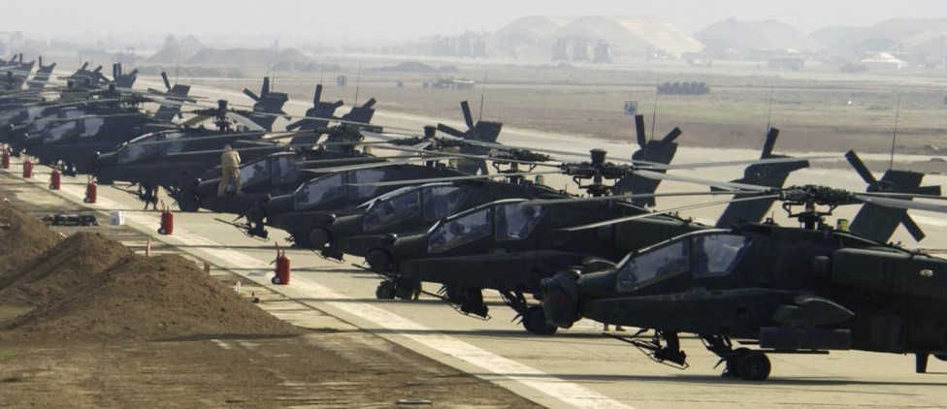
STAND 3
Pre-Mission Prep
3-1

Slide 12
Team Selection
Team Selection:
How To Select Crews from Across the Battalion
  Single Company?
  “All Star” Crews?
  Battle Rostered Crews?
  Pros and Cons
Mitigation of Mission or Personnel Changes
  Injury or Emergency Leave
  Changes to the Mission Plan
  Risk
3-2

Slide 13
Training
Training:
Challenges with an unknown mission
  Constant rehearsals at night
  Fuel range, familiarization flights with fuel pods
  Target assignments and weapons configuration
3-3

Slide 14
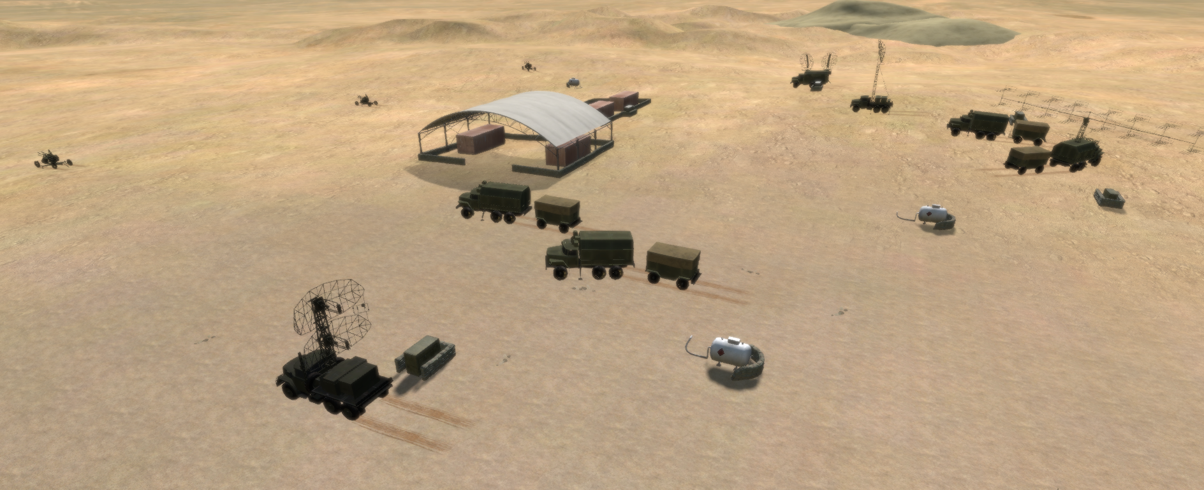
TF White Target Site
N
3-4

Slide 15
Training
Training:
Challenges with an unknown mission
  Constant rehearsals at night
  Fuel range, familiarization flights with fuel pods
  Target assignments and weapons configuration
Joint Operations
  Movement and attack techniques
  Pre-briefs and post-flight hot washes
OPSEC
  Cleared for the mission and had a need to know
  Never practiced the actual mission
  Movement to the ISB was classified
3-5

Slide 16
Interoperability
Interoperability:
Recent interoperability challenges
  Grenada and Panama
Equipment and TTPs
  Tactical radio capabilities and frequencies
  Night vision capabilities
“OK. Give ‘em a go”
GEN Norman Schwarzkopf, CENTCOM Commander
3-6

Slide 17
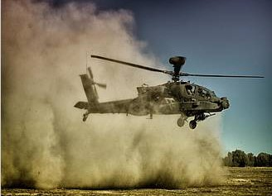
Desert Flight Challenges
Challenges with desert flying:
High air temperatures mean
less lift
Dust gets into everything
Erosion of rotor blades
Need for windscreen covers
Obstacle clearance
Poor visibility
Need for hover points
“You have to focus 100% on flying the aircraft every second. If you don't, it could kill you. It was a very challenging environment, so as leaders you must constantly reinforce the basics.”
1LT Tom Drew, Apache Flight Lead, Task Force White
3-7

Slide 18
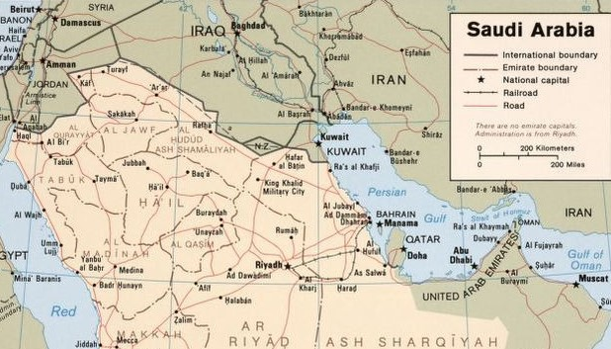
Movement to the ISB
15 January 1991
Ar Ar
Al Jouf
King Khalid
Military City
Camp Eagle II
King Faud
International Airport
3-8

Slide 19
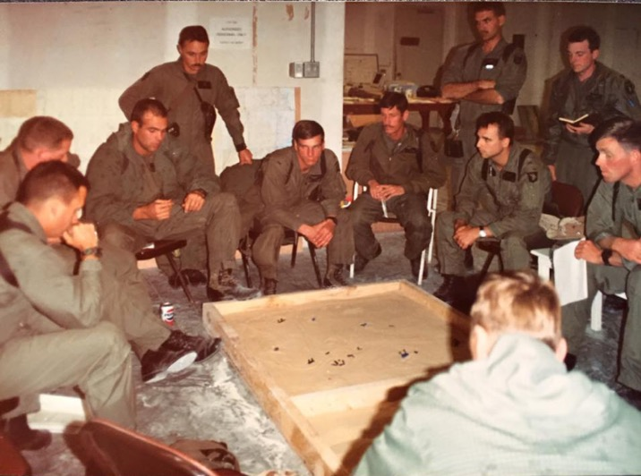
Final Mission Update Brief
16 January 1991 - 2130
Mission Brief:
What the actual mission was
Review of satellite photos
Verifying primary and
secondary targets
Possible enemy actions
CSAR / DART
Abort criteria
“I immediately had “butterflies” in my stomach. [I thought,] oh my gosh, the weight of the world is on this mission. A lot of people could die if we fail.”
Captain Mike Kingsley, Pave Low Flight Lead, Task Force Red
3-9

Slide 20
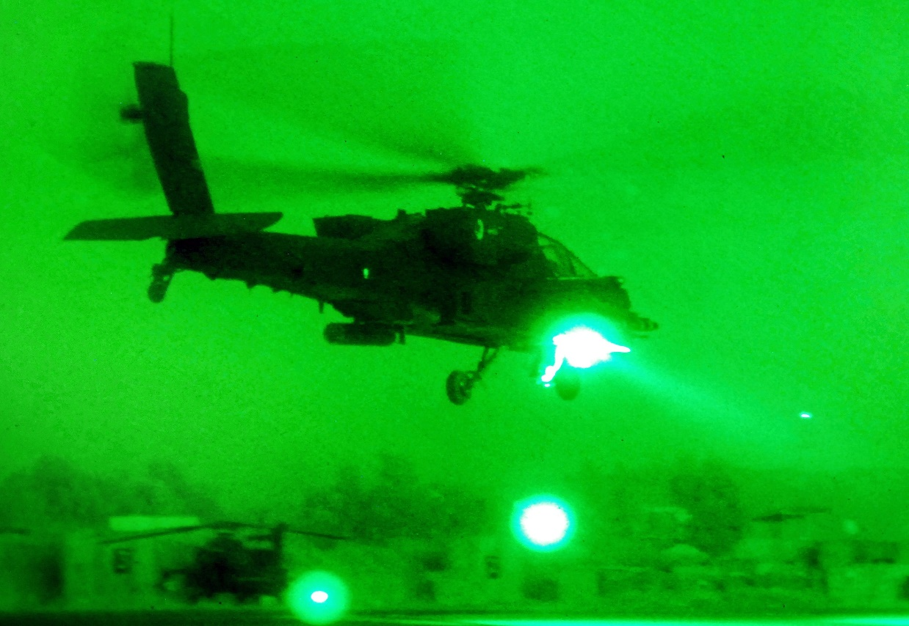
STAND 4
Movement / Actions on the Objective
4-1

Slide 21
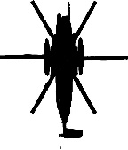
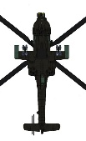

Alignment for Mission Execution
Task Force White
Task Force Red
Pave Low 1
Capt. Corby Martin
Capt. Bill Lemeanger
Pave Low 1
Capt. Mike Kingsley
Capt. Mike Beard
Pave Low
CSAR Mission
Pave Low 2
Capt. Ben Pulsifer
Capt. Penny Woodson
Pave Low 2
Maj. Robert Leonik
Lt. Col. Richard Comer
Pave Low
CSAR Mission
Apache 1
CW2 Brian Stewman
LTC Richard Cody
Apache 1
CPT Newman Shufflebarger**
CW2 Tim Roderick
Apache 2
CW2 Tim Zarnowski
1LT Thomas Drew**
Apache 2
WO1 Jody Bridgforth
CW3 Jim Miller
AH-64
Spare Apache
Apache 3
CW2 Lee Miller
CW2 Ron Rodrigues
Apache 3
WO1 Tim Vincent
CW2 Shawn Hoban
UH-60
DART Mission
Apache 4
CW2 Thomas O’Neal
CW3 David Jones
Apache 4
CW2 Jerry Orsburn
CW4 Lou Hall
** Flight Lead
4-2

Slide 22



Mission Overview
40 Miles
Iraq
Saudi Arabia
Saudi Arabia
Iraq
4-3
4-2

Slide 23
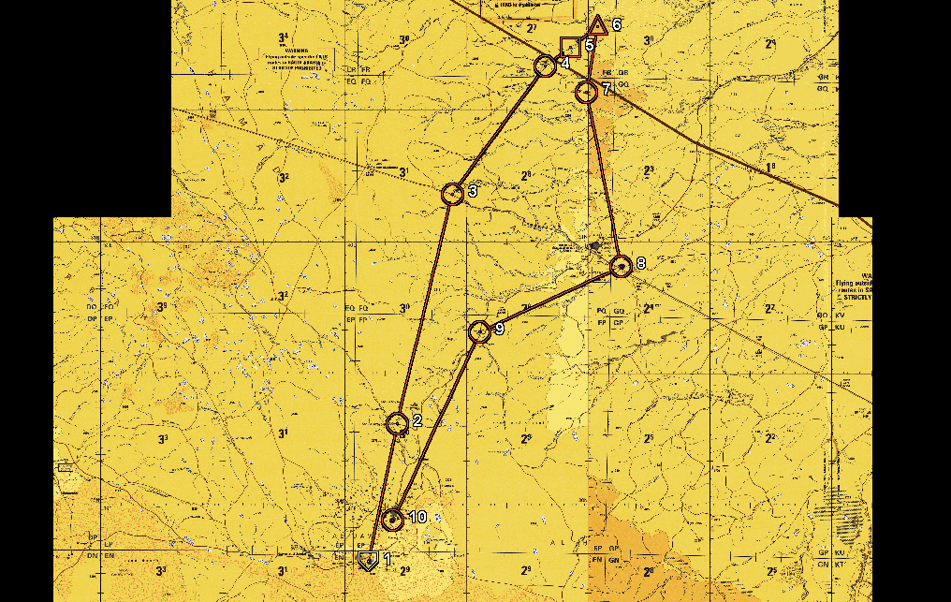
Captain Martin’s Map
Chem Light
Bundle Drop
Target
Location
Checkpoint
Checkpoint and
Course Change
Checkpoint and
Course Change
Iraq
Saudi Arabia
Checkpoint and
Course Change
Checkpoint
Final Checkpoint and
Course Change
Al Jouf
Start Point
Al Jouf
EOM
0
Miles
25
Miles
4-4
4-2

Slide 24
Confirming Positions
Chem Light
Bundle Drop
Target
Location
Checkpoint
Checkpoint and
Course Change
Iraq
0
Miles
10
Miles
Saudi Arabia
4-5
4-2

Slide 25
Movement to the Objective
Iraq
Saudi
Arabia
Saudi
Arabia
Iraq
0
Miles
10
Miles
4-6
4-2

Slide 26
Actions on the Objective
Iraq
Saudi
Arabia
Saudi
Arabia
Iraq
0
Miles
10
Miles
4-7
4-2

Slide 27
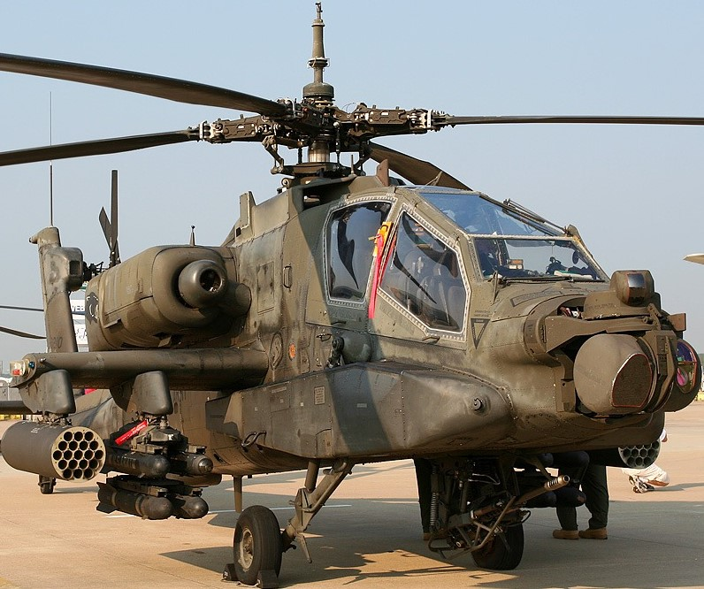
STAND 5
Post-Mission
5-1

Slide 28
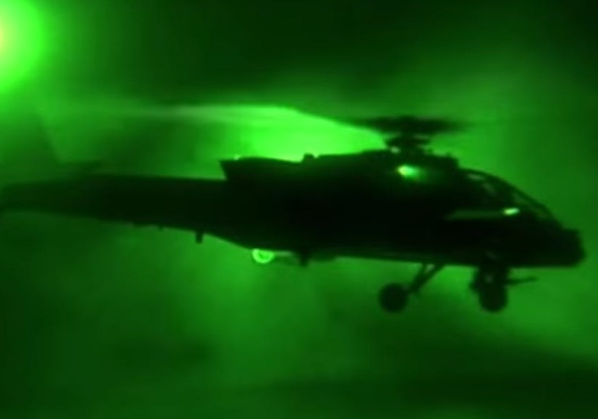
BDA and Mission Impact
Battle Damage Assessment
All radars and communications
equipment destroyed
Radars permanently offline
Nothing left to destroy
Mission Impact on Desert Storm
Set conditions for the air campaign
Allowed aircraft to follow original attack plans
What would have happened if the
mission was NOT a success?
5-2

Slide 29
Integration
Task Force Normandy

